Slide 1

Dynamic Customer Behavior Segmentation & Retail Analytics Platform
Phase 2- Mid Term Presentation for Industry Project
Aditya Chitransh
225891212
Under Supervision
Dr. Ignisha Rajathi G
Mr. Aman Ashwin

Slide 2

Internship Company Details
Company Name: BeatRoute
Domain: AI-driven Sales Enablement & Retail Intelligence
Role: AI/ML Intern
Duration: September 2025 – April 2026
Key Responsibilities:
Worked on AI-based solutions for retail and sales automation
Contributed to development of intelligent agents (Sales Agent, Invoice Agent, Audit Agent)
Assisted in analysing customer and transaction data for business insights
Implemented and tested backend logic for data processing and automation workflows
Collaborated with team members using Git and version control

Slide 3
Internship Company Details
Technologies Used:
Python
Machine Learning concepts
Docker (for containerization)
Git & GitHub
Data processing using pandas
Learning Outcomes:
Gained practical experience in applying AI/ML to real-world business problems
Understood how data-driven systems are built and deployed
Improved skills in backend development and system design
Learned how analytics can be used to support business decision-making

Slide 4
INTRODUCTION
In today’s retail environment, companies generate a huge amount of transaction data on a daily basis. However, most of this data is not effectively used for decision-making.
Businesses often struggle to identify which customers are truly valuable and how their behavior changes over time.
This project focuses on building a system that can automatically analyze customer data, segment them into meaningful groups, and present the results through an interactive dashboard.
The aim is to make customer data more useful and easier to understand.

Slide 5
Problem Statement
Most businesses collect large amounts of customer data but struggle to use it effectively.
Customer segmentation is often done manually or using fixed methods, which do not scale well and fail to capture changing behavior.
There is a need for a system that can automatically analyze data, segment customers, and provide clear insights in an efficient way.

Slide 6
Objectives of this project
To segment customers based on their behavior using data-driven methods.
To apply machine learning techniques for accurate grouping
To visualize the results in an interactive dashboard
To generate meaningful insights from the data
To design a system that is modular and scalable

Slide 7
LITERATURE REVIEW
Existing solutions
Customer segmentation has been widely studied using techniques like RFM analysis, which considers recency, frequency, and monetary value.
Clustering algorithms such as KMeans are commonly used to group customers based on similar behavior.
However, most existing solutions focus only on analysis or require manual setup using tools like BI dashboards.

Slide 8
Gaps Identified
Lack of fully automated segmentation systems
Use of fixed cluster values instead of optimized ones
Limited integration between machine learning and visualization
Lack of clear business insights from the results

Slide 9
PROPOSED SOLUTION
Approach
Developed a system that combines data processing, machine learning, and visualization into one platform.
The system calculates customer behavior metrics, applies clustering to group customers, and displays the results through an interactive dashboard.
It also generates insights to help understand the data better.

Slide 10
How It Improves Upon Existing Solutions
Automates the entire segmentation process
Uses cluster optimization instead of fixed values
Provides an interactive and user-friendly dashboard
Generates business insights instead of just raw results
Designed in a modular way for easier future expansion

Slide 11
METHODOLOGY
System Architecture / Workflow Diagram
The system follows a structured workflow:
Raw Data
Data Preprocessing
RFM Feature Calculation
Feature Scaling
KMeans Clustering
Cluster Optimization
Segment Labelling
Dashboard Visualization

Slide 12
Tools, Technologies, and Frameworks Used
Python for implementation
pandas and numpy for data processing
scikit-learn for machine learning (KMeans, PCA)
plotly for interactive charts
streamlit for building the dashboard

Slide 13
Implementation Steps
Load and preprocess the dataset
Calculate RFM features for each customer
Normalize the data using StandardScaler
Apply KMeans clustering
Optimize the number of clusters using evaluation metrics
Label clusters based on customer value
Visualize results using charts and dashboard

Slide 14
EXPERIMENTAL SETUP & DATASET
Description of Dataset Used
The dataset contains real transaction-level data of retailers.
Size: approximately 51 MB
More than 5,000 retailers
Includes order details, product information, and pricing
From this data, features like recency, frequency, monetary value, and product range are calculated.

Slide 15
Experiment Configurations and Parameters
KMeans clustering used for segmentation
Cluster range tested from k = 2 to 10
Silhouette score used to select optimal clusters
Data scaled using StandardScaler
PCA used for visualization of clusters

Slide 16
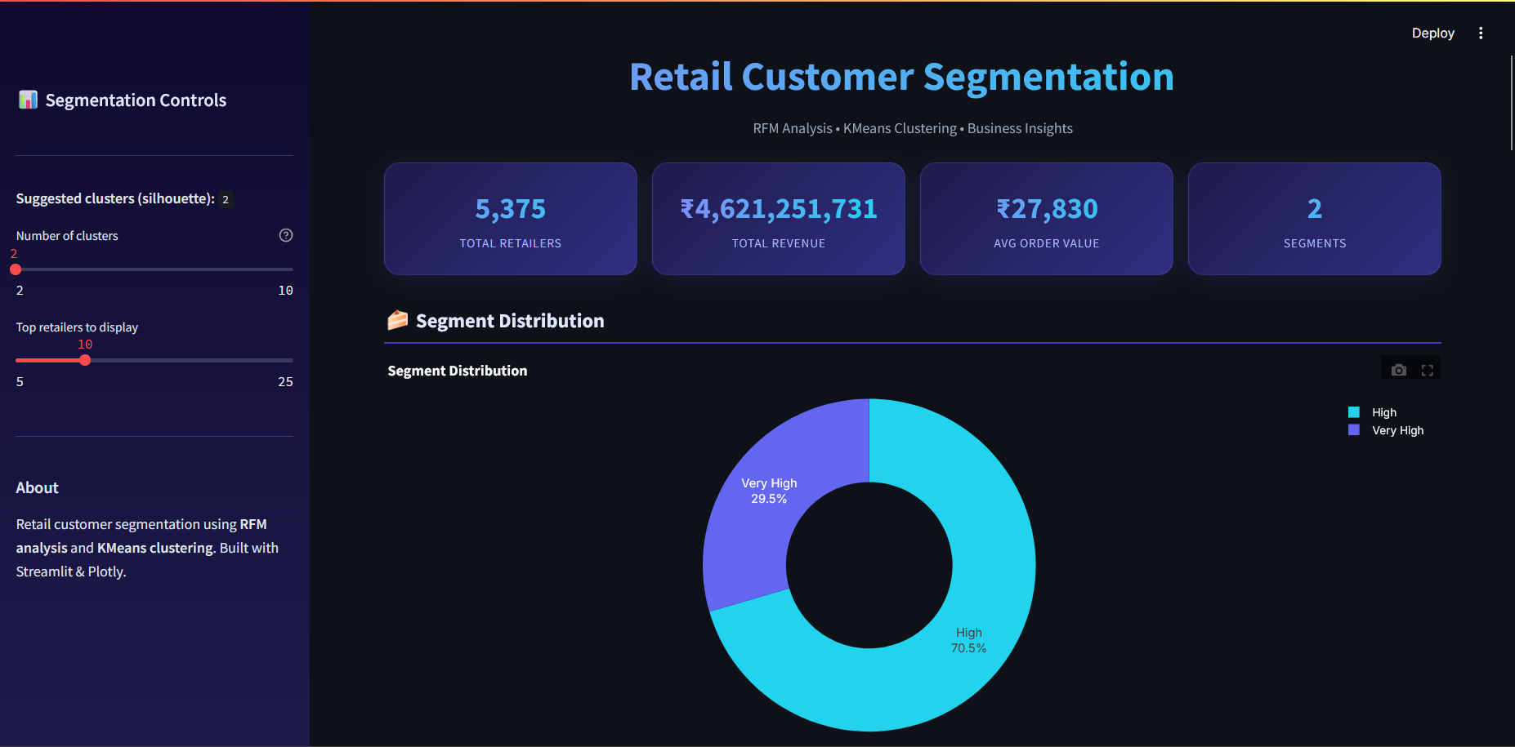
IMPLEMENTATION & FEATURES

Slide 17
Key Functionalities of the Project
Automated customer segmentation
Cluster optimization for better grouping
Interactive dashboard with multiple visualizations
Revenue analysis by customer segments
Identification of top customers
Automatic generation of insights

Slide 18
RESULTS & ANALYSIS
Performance Metrics
Silhouette Score used to evaluate cluster quality
Davies-Bouldin Index used to measure separation
Calinski-Harabasz Index used to evaluate variance
These metrics confirm that the clustering is meaningful and well-structured.

Slide 19
Comparisons with Existing Methods
Compared to traditional static segmentation methods, this system:
Provides more accurate grouping using optimized clusters
Automates the entire process
Offers interactive visualizations instead of static results

Slide 20
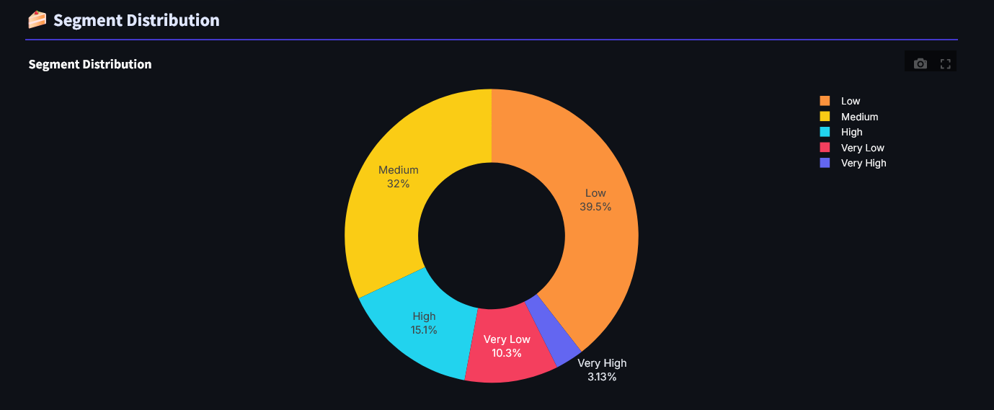
Segment Distribution

Slide 21
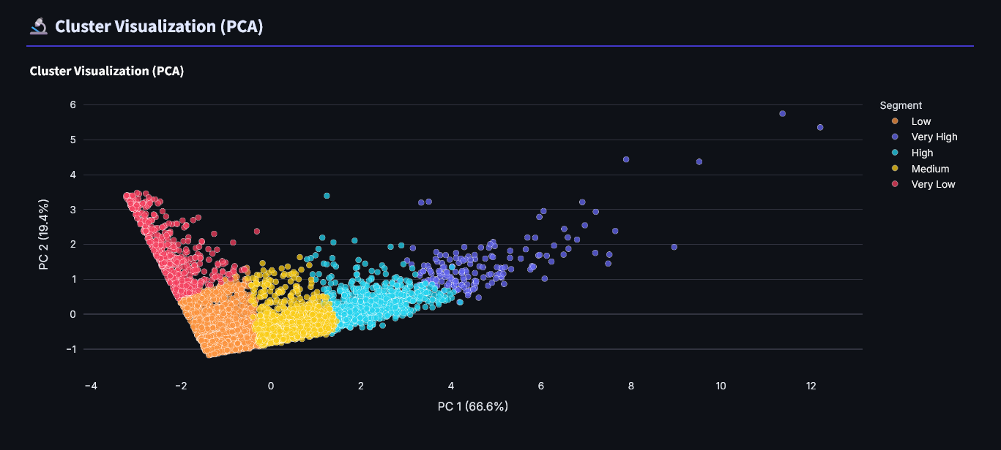
Cluster Visualization

Slide 22
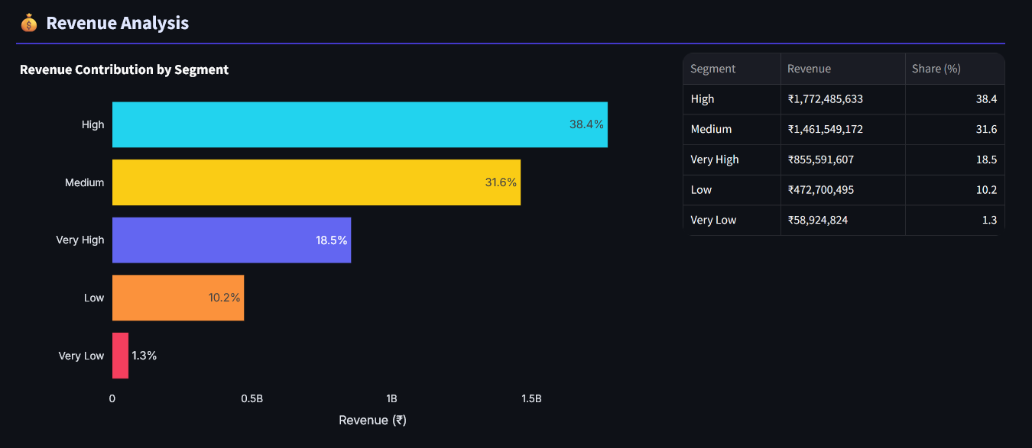
Revenue Analysis

Slide 23
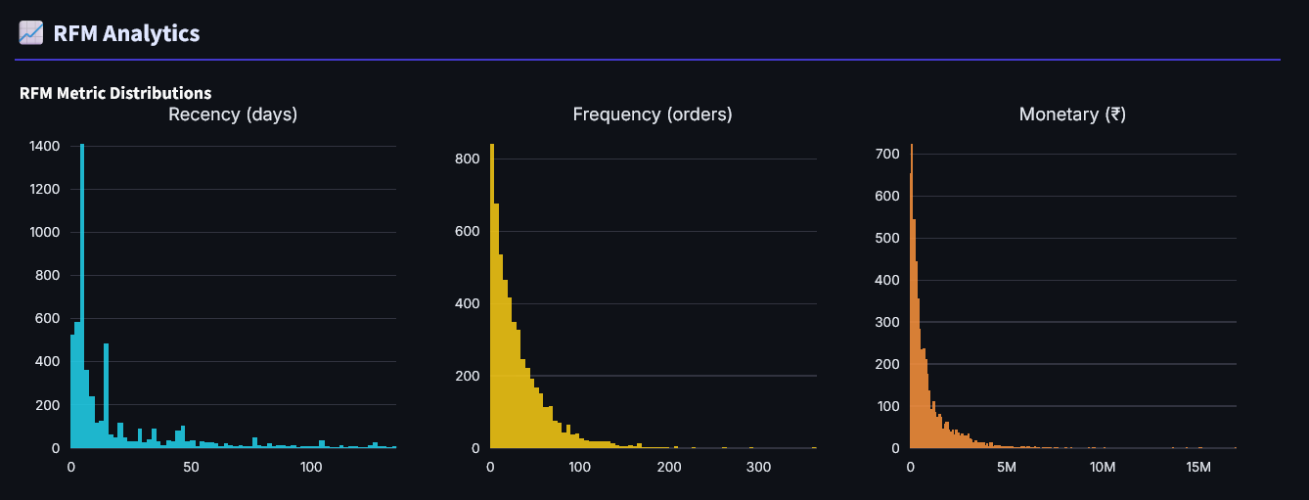
RFM Analytics

Slide 24
CHALLENGES & LIMITATIONS
Issues Faced During Development
Handling large datasets efficiently
Selecting the optimal number of clusters
Ensuring proper feature scaling
Designing a clean and responsive dashboard

Slide 25
Limitations of the Proposed Solution
Currently uses a static dataset
Does not include predictive models yet
Limited to Streamlit-based UI
Real-time data processing not implemented

Slide 26
CONCLUSION
Summary of Findings
The project successfully segments customers into meaningful groups based on their behavior.
It demonstrates how machine learning can be used to analyze large datasets and extract useful insights.
The dashboard makes it easier to understand and interpret the results.

Slide 27
Key Takeaways
Customer data can provide valuable business insights
Machine learning improves segmentation accuracy
Visualization helps in better decision-making
A modular system allows easy future improvements

Slide 28
REFERENCES
[1] R. Kumar and S. Singh, “Customer Segmentation Using RFM Analysis and K-Means Clustering,” International Journal of Computer Applications, vol. 181, no. 19, pp. 1–6, Oct. 2018.
[2] T. F. Cox and M. A. A. Cox, Multidimensional Scaling, 2nd ed. Boca Raton, FL, USA: Chapman & Hall/CRC, 2000.
[3] J. Han, M. Kamber, and J. Pei, Data Mining: Concepts and Techniques, 3rd ed. San Francisco, CA, USA: Morgan Kaufmann, 2012.
[4] A. Jain, M. N. Murty, and P. J. Flynn, “Data Clustering: A Review,” ACM Computing Surveys, vol. 31, no. 3, pp. 264–323, Sept. 1999.
[5] P.-N. Tan, M. Steinbach, and V. Kumar, Introduction to Data Mining, Boston, MA, USA: Pearson Education, 2014.
[6] F. Pedregosa et al., “Scikit-learn: Machine Learning in Python,” Journal of Machine Learning Research, vol. 12, pp. 2825–2830, 2011.
[7] I. T. Jolliffe, Principal Component Analysis, 2nd ed. New York, NY, USA: Springer, 2002.
[8] R. S. Winer, “A Framework for Customer Relationship Management,” California Management Review, vol. 43, no. 4, pp. 89–105, Summer 2001.
[9] B. McCarty and T. Hastak, “Segmentation Approaches in Data-Driven Marketing,” Journal of Marketing Analytics, vol. 5, no. 3, pp. 123–134, 2017.

